Slide 1

SONG RECOMMENDATION SYSTEM
Capstone Project
MIT-IDSS Oct20-B – GROUP 4
Presented by : Angad Bagga
Lakshminaryanan
Sachin Sawant
Sudeep :

Slide 2

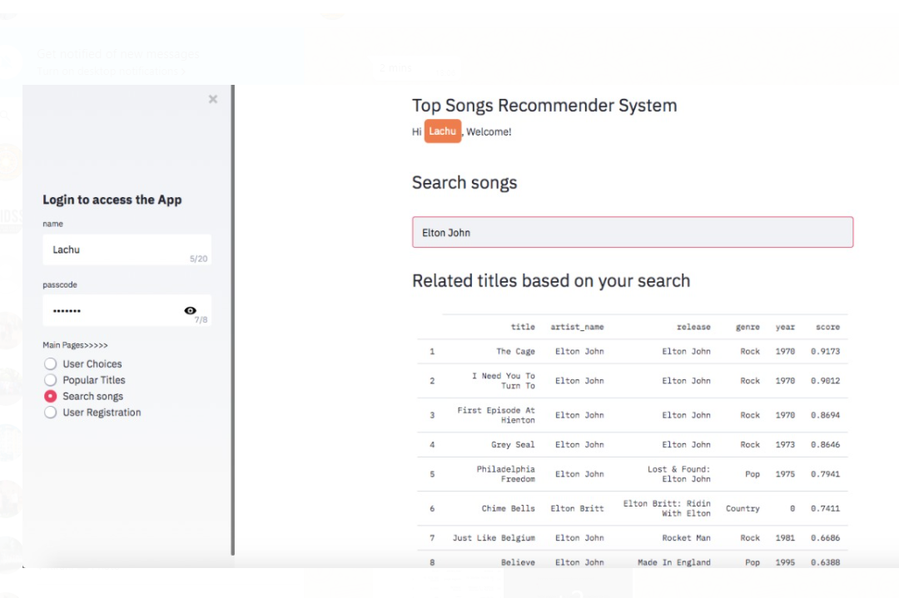
Approach - Project Roadmap
Loading the data in Google colab
EDA
Popularity based filtering
Content based filtering
Collaborative filtering
Understanding the problem and Impact
Solution demonstration on UI and effectiveness
Comparative Analysis
One of the snap shots from the UI being created using stream lit
Sample Text

Slide 3
Project Roadmap

Slide 4
Music heals the soul
Capstone Project
Thanks

